Slide 1
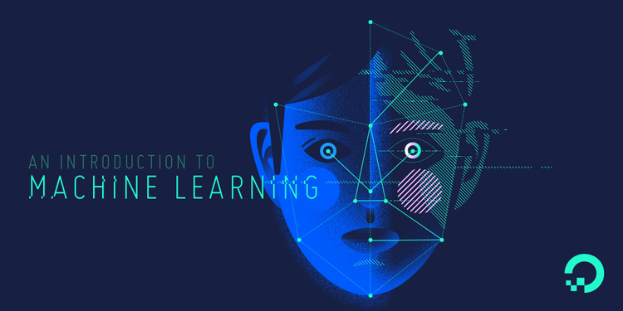
ML

Slide 2
What is Machine Learning?

Slide 3
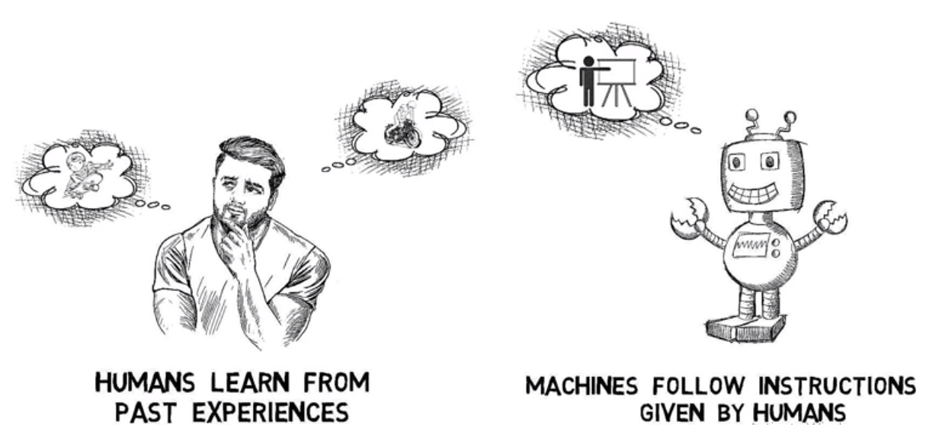

Slide 4
Machine learning is a kind of AI that enables computers to think and learn on their own.
Data Science - set of techniques , extract info from data.
Data Mining - Collect data , search pattern, predict.
Data Analysis – sense of data.

Slide 5
What is it used for?
Fraud detection.
Web search results.
Real-time ads on web pages
Credit scoring and next-best offers.
Prediction of equipment failures.
New pricing models.
Network intrusion detection.
Recommendation Engines
Customer Segmentation
Text Sentiment Analysis
Predicting Customer Churn
Pattern and image recognition.
Email spam filtering.
Financial Modeling

Slide 6
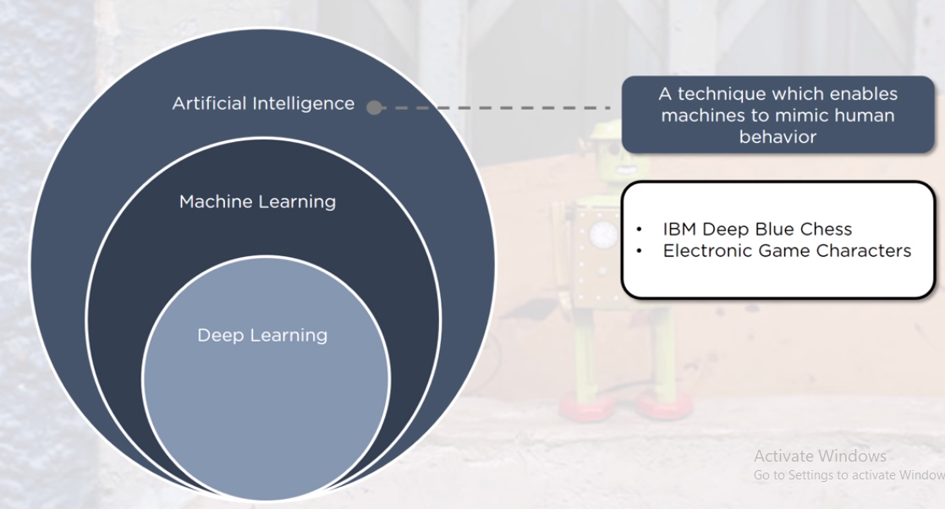

Slide 7
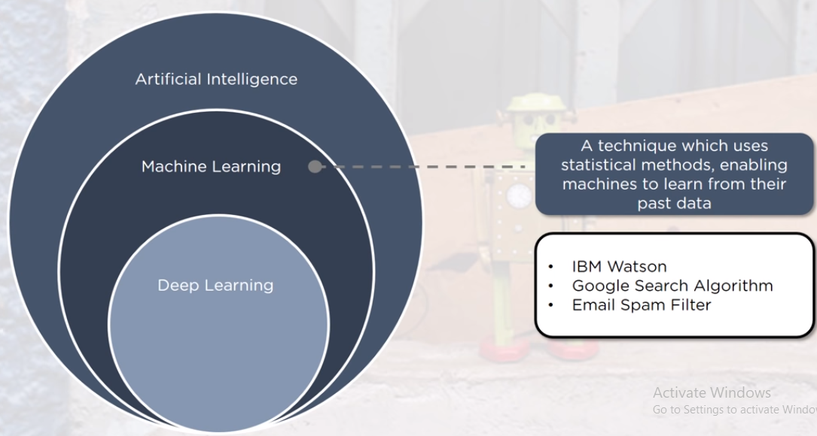

Slide 8
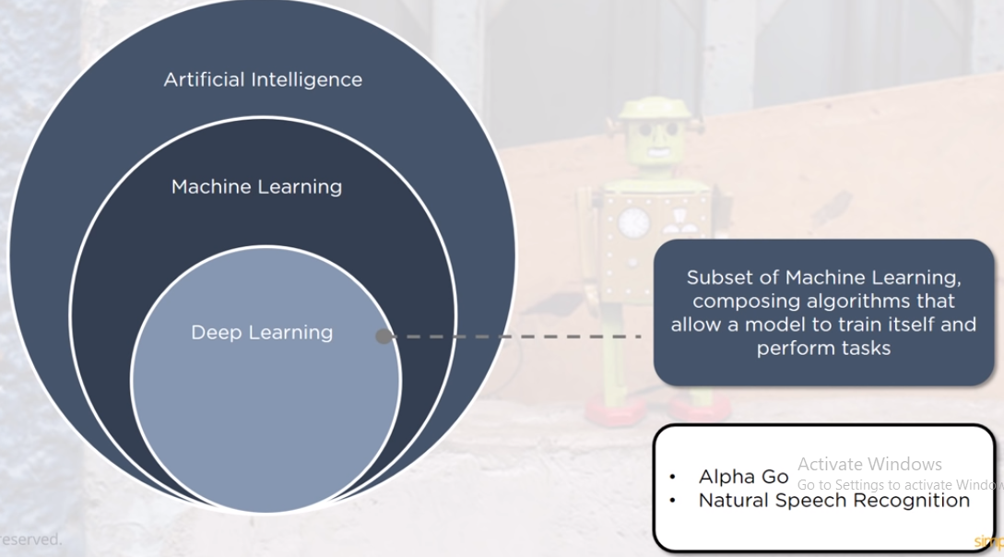

Slide 9
ML
Machine Learning is a system that can learn from example through self-improvement and without being explicitly coded by programmer.
Machine learning combines data with statistical tools to predict an output.

Slide 10
EXAMPLE
For those who have a Netflix account, all recommendations of movies or series are based on the user's historical data.
Machine learning is also used for a variety of task like fraud detection, predictive maintenance.

Slide 11
Applications
of
Machine Learning

Slide 12
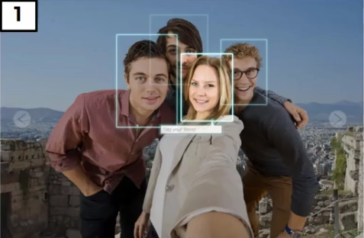
Auto Friend tagging Suggestion

Slide 13
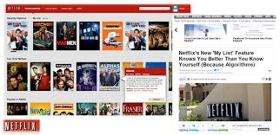
Netflix and amazon
Recommender system.

Slide 14

Uber eats

Slide 15
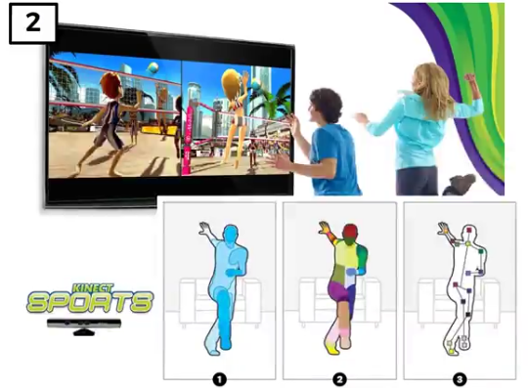
KINECT Sports

Slide 16
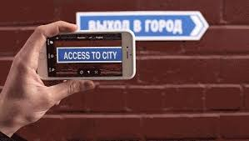
Google translate

Slide 17
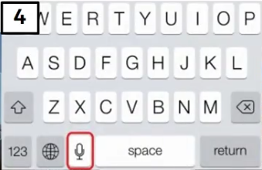
Speech to Text Conversion

Slide 18
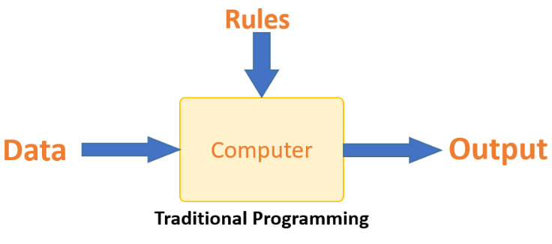
Traditional Programming

Slide 19
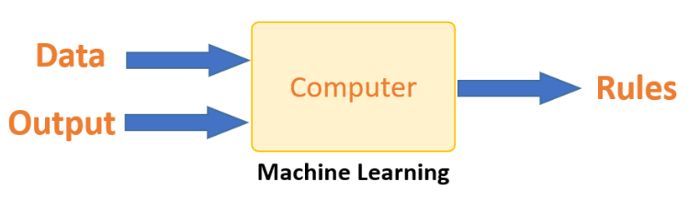
ML

Slide 20
How does Machine learning work?
The way the machine learns is similar to the human being.
The core objective of machine learning is the learning and inference.
The list of attributes used to solve a problem is called a feature vector. Used to tackle a problem.

Slide 21
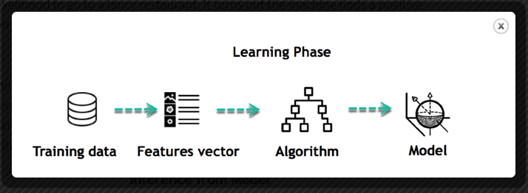
Train Data

Slide 22
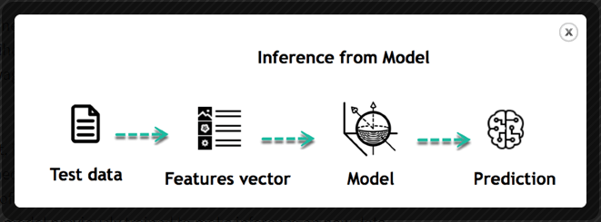
Test Data

Slide 23
The life of Machine Learning
Collect data
Visualize data
Feature Extraction
Train algorithm
Test the Algorithm
Use the model to make a prediction

Slide 24
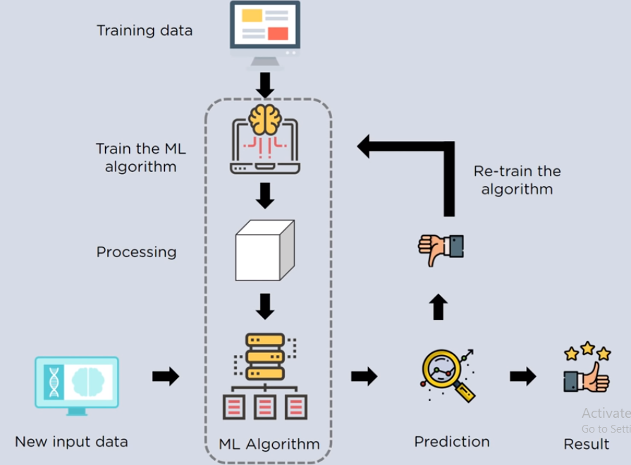

Slide 25
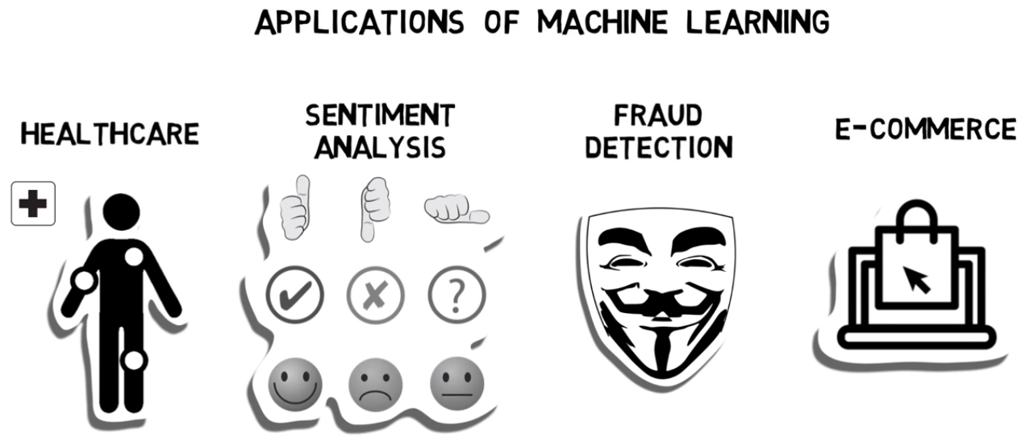

Slide 26
TYPES of Learning
Supervised Learning
Unsupervised Learning
Reinforcement Learning

Slide 27
Supervised vs. Unsupervised
Supervised uses Labeled Data
Unsupervised uses Unlabeled Data

Slide 28
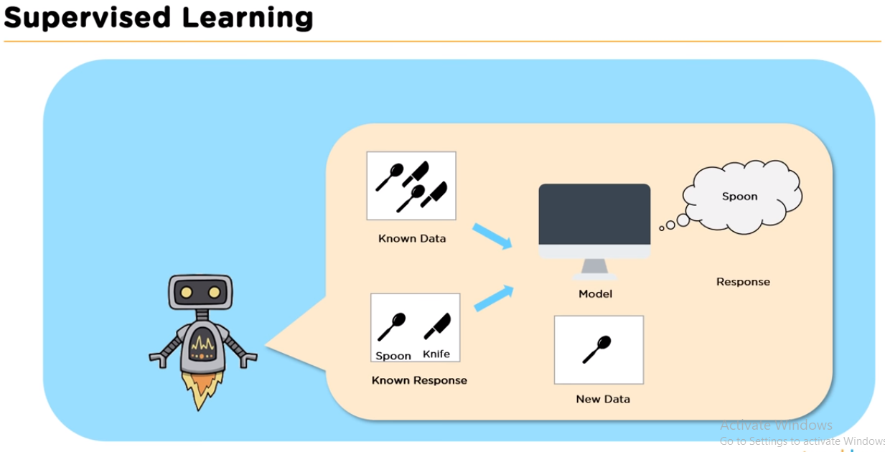
Supervised Learning

Slide 29
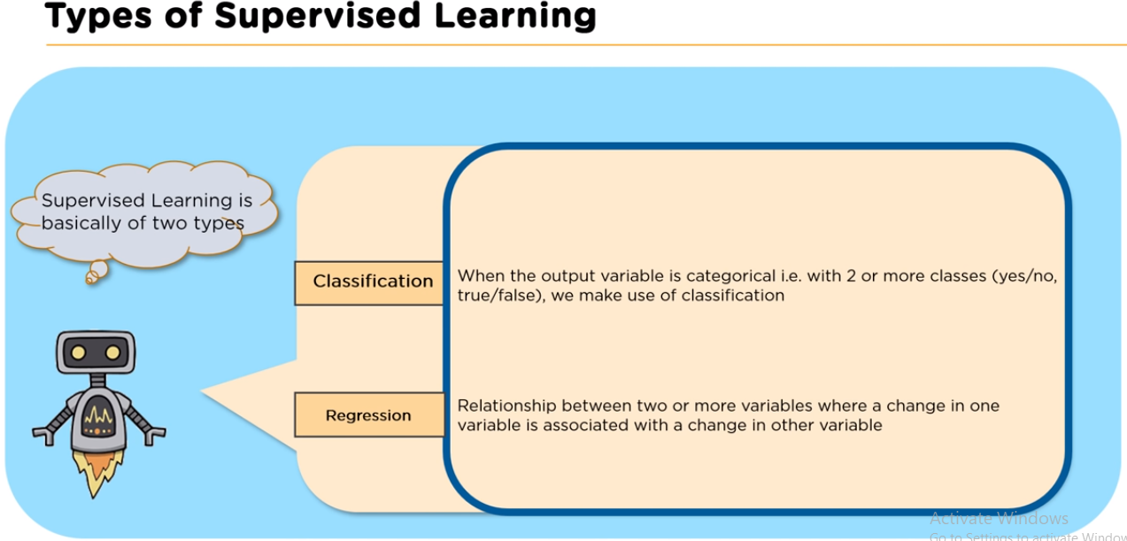

Slide 30
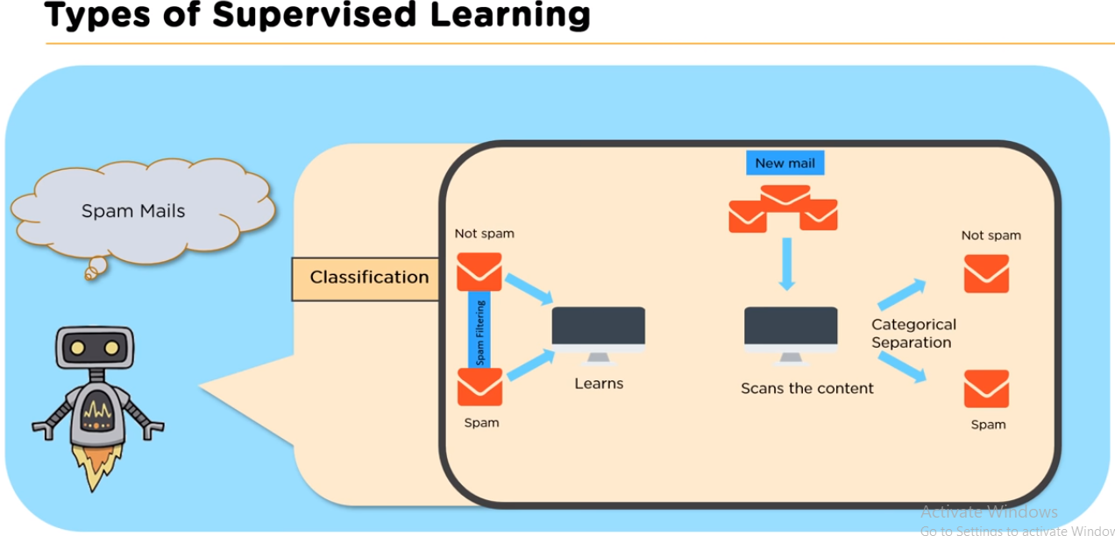

Slide 31
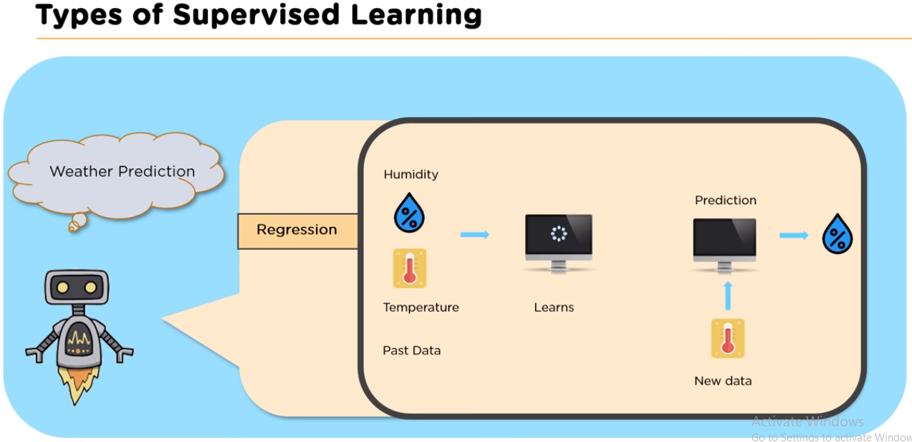

Slide 32
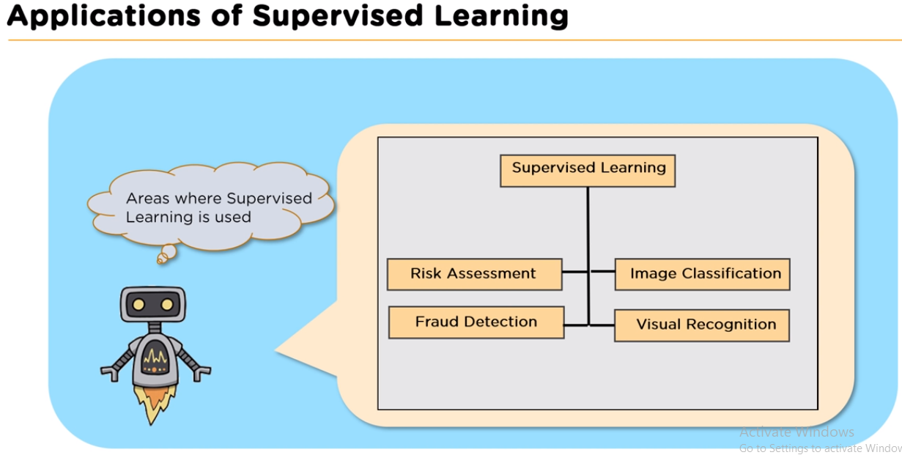

Slide 33
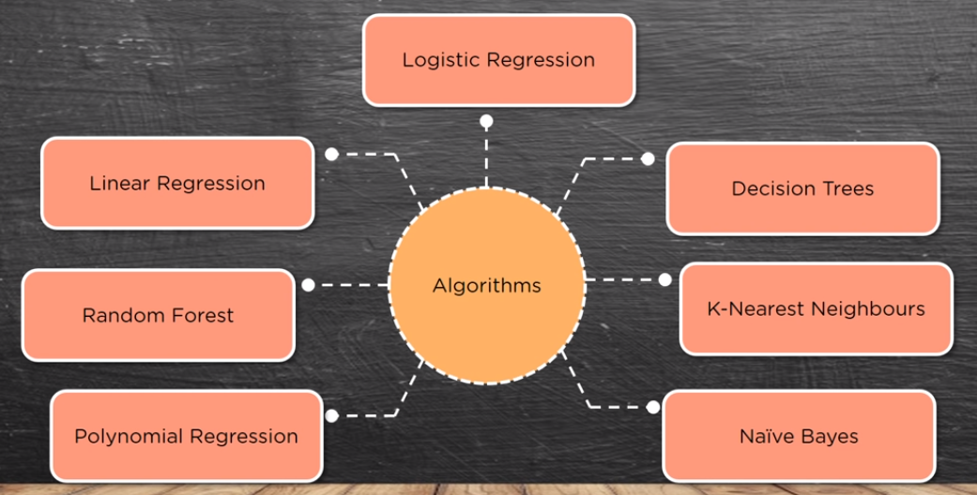

Slide 34
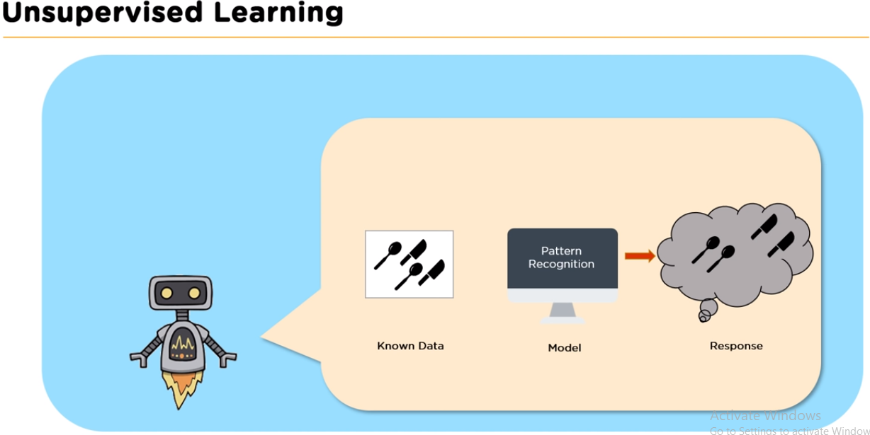

Slide 35
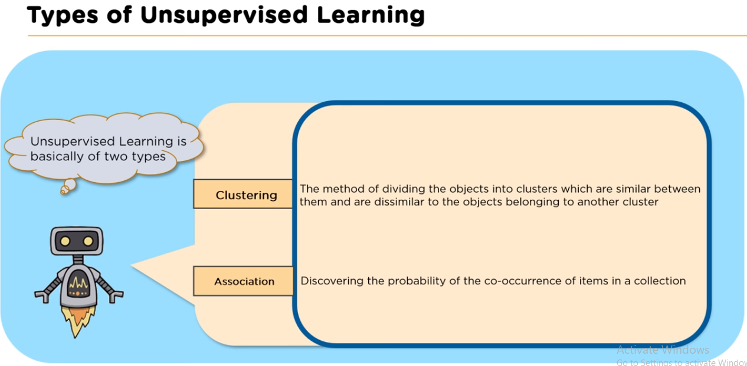

Slide 36
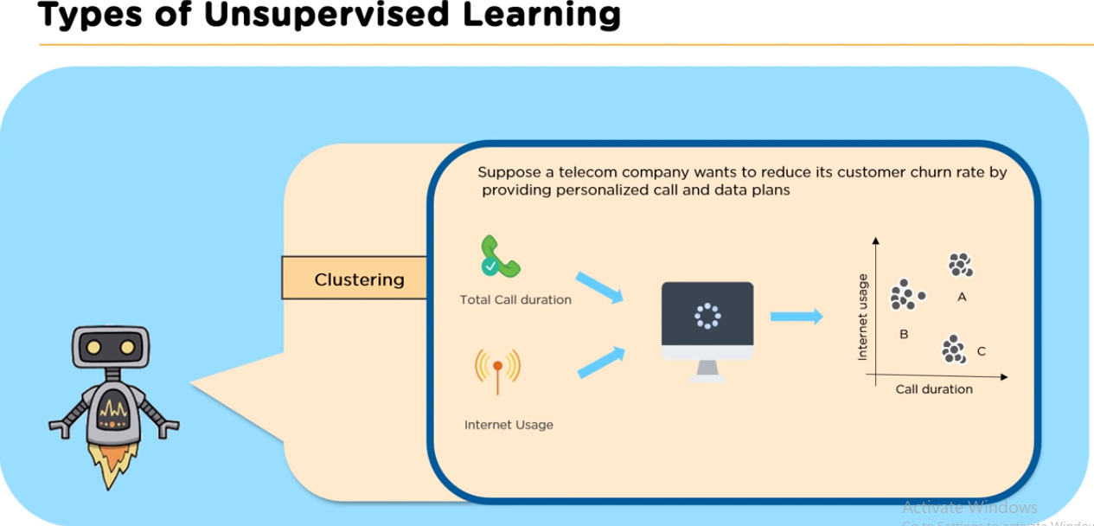

Slide 37
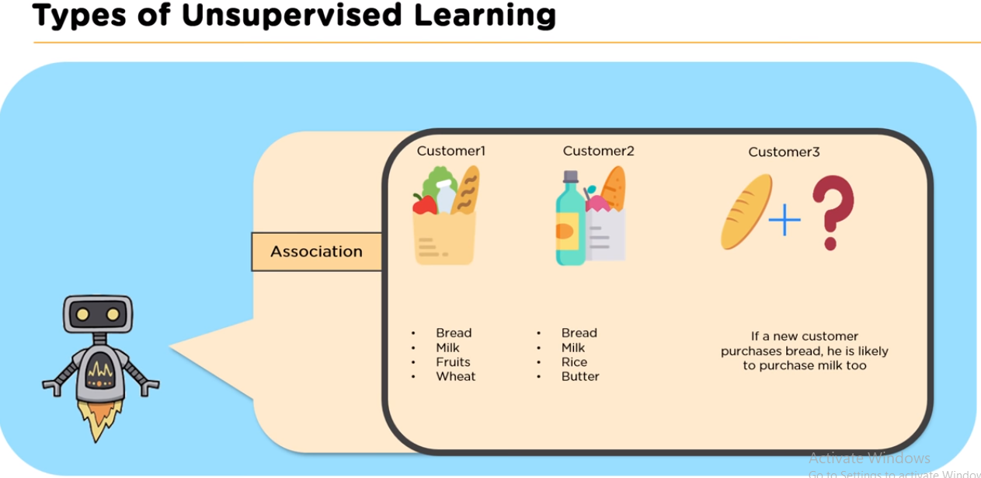

Slide 38
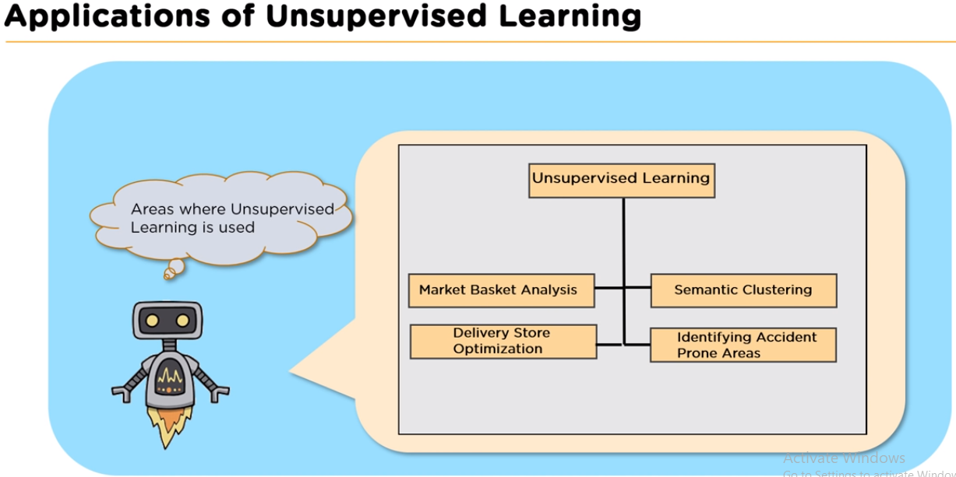

Slide 39
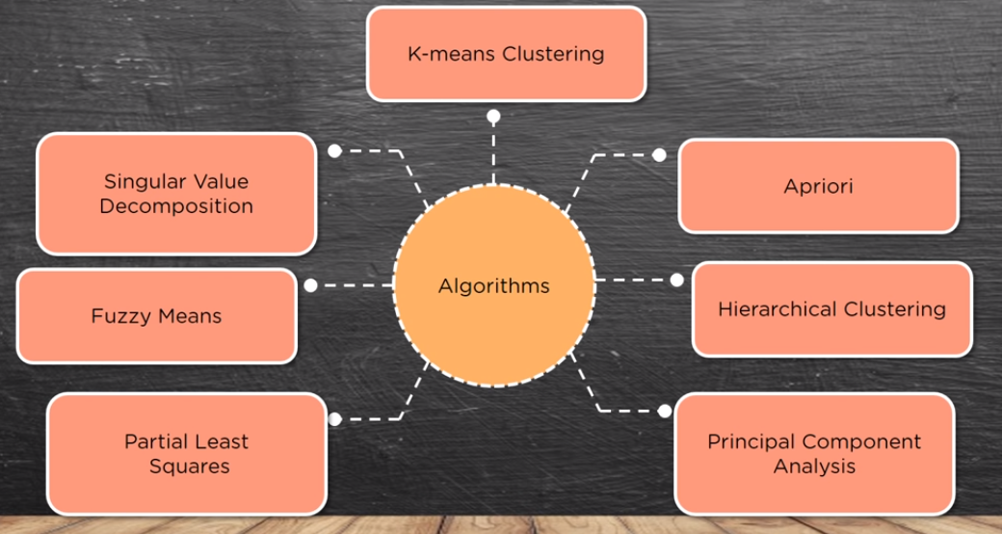

Slide 40
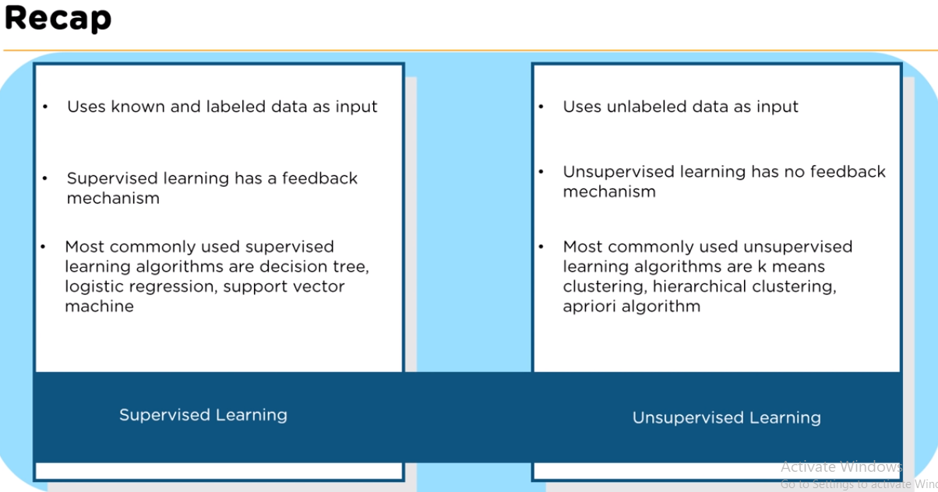

Slide 41
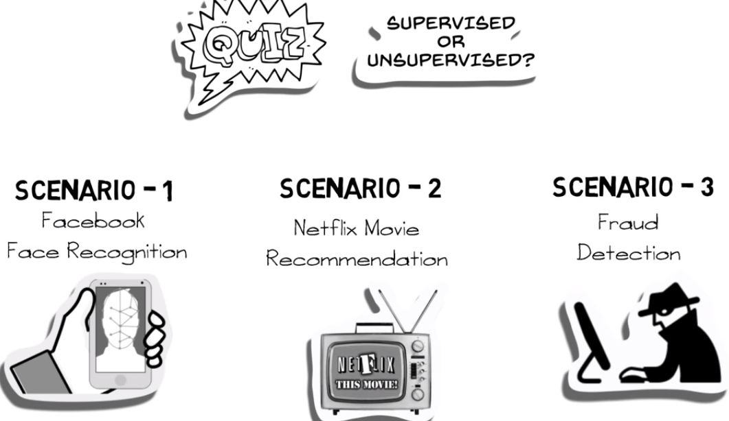

Slide 42
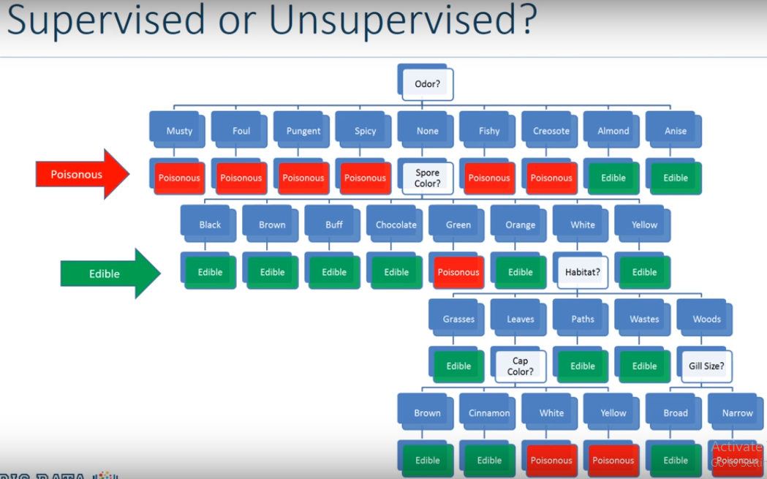

Slide 43
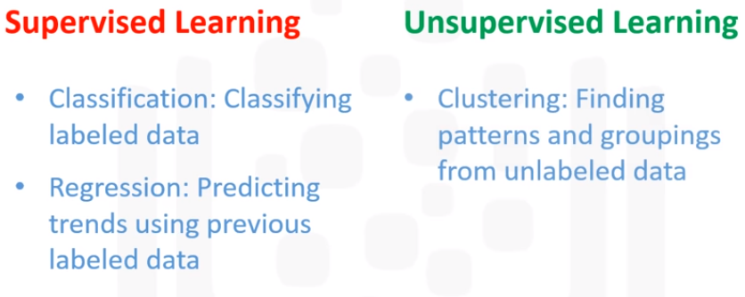

Slide 44
Reinforcement Learning
Reinforcement learning is all about making decisions sequentially. In simple words we can say that the out depends on the state of the current input and the next input depends on the output of the previous input.

Slide 45
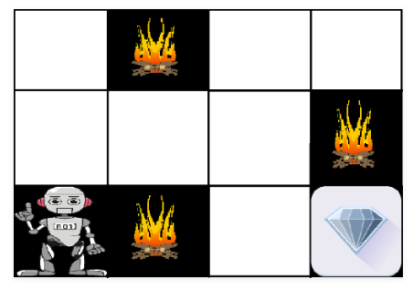

Slide 46
Applications of Reinforcement Learning
RL can be used in robotics for industrial automation.
RL can be used in machine learning and data processing
RL can be used to create training systems that provide custom instruction and materials according to the requirement of students.

